Slide 1
Serverless and Containers with AWS and .NET Core
Norm Johanson, Senior Software Engineer at AWS

Slide 2
Goals for today?
Serverless
Define and learn the AWS implementation for Serverless
Container Environment
Overview and compare with Serverless
Learn what AWS offers for Containers
Help choose the right technology

Slide 3
Choosing the right tech
Solve technical requirements
Execution Speed
Latency
Networking (i.e. persisted connections)
…
Cost
Operational Cost
Engineering Cost

Slide 4
Serverless

Slide 5
What does it mean to be Serverless?
Continuous Scaling
Instantly scales up or down based on the current demand
No need to auto provision
No Servers to Manage
Focus on writing application specific code
Cost based on function execution time
No charges for idle functions

Slide 6
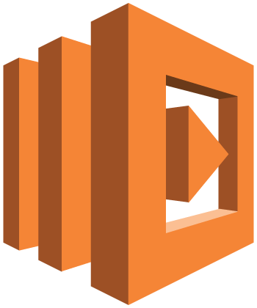
AWS Lambda
Event Based
HTTP Events (via Amazon API Gateway)
Service Events (i.e. Amazon S3 and Amazon DynamoDB)
Custom Events (Invoked by any of the AWS SDKs)
Configuration
Memory (Indirectly CPU)
Timeout (Max 5 Minutes)
Billing at per 100 ms for function execution time
Supported Runtimes
.NET Core, Node.js, Go, Python, Java

Slide 7
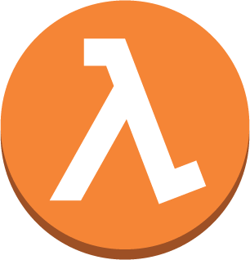
Lambda Lifecycle
First event
New compute environment (C1)
Cold start
Processes event
C1 freezes
Second event
Warm start
C1 thaws and process event
C1 freezes
2 events come in
1 event reuses C1
2 second event creates C2
C1 and C2 freeze
C1 and C2 are removed after a period of inactivity

Slide 8
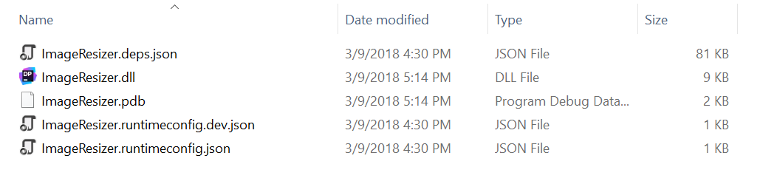
What is a .NET Core Lambda Function
.NET Core 2.0 project (targeting netcoreapp2.0)
Packaged using dotnet publish
Highly recommend using an AWS tool to create the package
AWS Toolkit for Visual Studio
Amazon.Lambda.Tools – Extension to the dotnet CLI

Slide 9
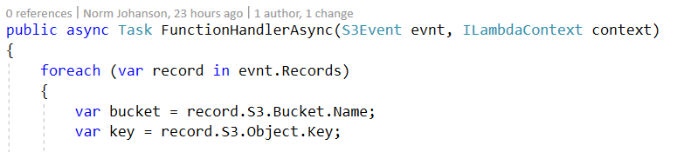
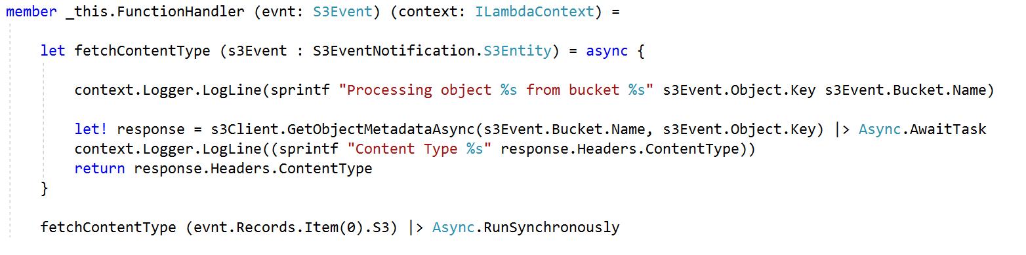
Coding a .NET Core Lambda Function
Function handler: <assembly>::<full type name>::<method>
C#
F#

Slide 10

ASP.NET Core on Lambda
Lambda function
Amazon API Gateway
NuGet Package Amazon.Lambda.AspNetCoreServer
Bridges API Gateway and ASP.NET Core
Pros
Powerful framework and constantly improving
Easy to migrate existing applications
Little new to learn to be serverless
Cons
Larger package bundle
Cost to initialize ASP.NET Core Framework

Slide 11
Demo Time

Slide 12
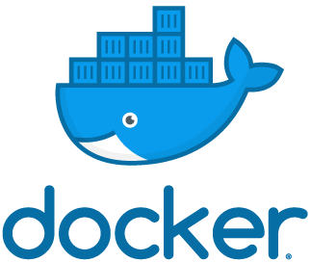
Containers

Slide 13
Benefits of Containers
Rich and powerful tool chain that works anywhere
Docker CLI
Image Registry (Docker Hub or Cloud Provider registry)
Cloud or On-Premise agnostic
Application Packaging (Images)
Any type of application
Isolation between running application
Fast Deployments and Scaling

Slide 14
Parts of a Container Application (Docker)
Container Image
An immutable image of your application and all of it’s dependencies
Docker Runtime
Governs the running of image on a server
Controls the interaction of the container and the host machine
Orchestration
Manages the layout of running containers across a cluster of servers

Slide 15
Container Images vs Lambda Package Bundle
Container Image
Contains all application bits including down to the OS Level
.NET Core Linux images typically around 100-200 megs
Lambda Package Bundle
Application-only bits in a zip file
Typically a few megs. Lambda max size 50 Megs

Slide 16
Orchestration
Scaling
Add and remove containers based on metrics
Durability & Placement
Spread containers across Servers
Service Discovery
Connecting services with each other

Slide 17
The Container Cluster
The servers that run containers
EC2 Instances in AWS
Spread servers out (AWS: Different availability zones)
Managed
Spin up and down servers as needed
Unmanaged
Manually launch servers into clusters
Use automation

Slide 18
AWS Container Services

Slide 19

AWS Batch
Designed for batch workloads
Jobs
Execute containers
Jobs can be dependent on other jobs
Job Queues
Priority Based
Compute Environments
Managed (On-Demand or Spot Instances)
Unmanaged (You supply EC2 Instances to cluster)

Slide 20

AWS CloudTrail and AWS Batch Demo
Problem: Find out over the past year how many Lambda Functions were created for each Lambda runtime
Solution: CloudTrail provides audit logs saved to S3 that we can parse.
S3 Key Prefix has the following pattern:
AWSLogs/<account-id>/CloudTrail/<region>/YYYY/MM/DD/file.json.gz

Slide 21

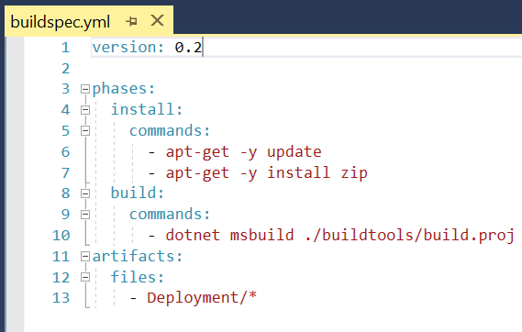
AWS CodeBuild
Fully managed build service
Build scripts execute in container
.NET Core 2.0 image
Custom images
i.e. microsoft/dotnet:2.1-sdk
Can build container images

Slide 22
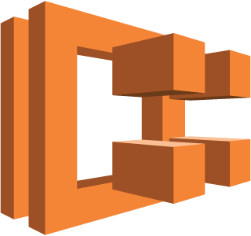


Amazon Elastic Container Service (ECS)
ECS cluster
Container Instances -> EC2 instances
Task definition
Defines Docker images, memory, cpu, etc.
Running tasks
Transitory process
Container Registry (Amazon ECR)
Services
Long-lived process
Load balancer
ECS registers tasks
Traffic flows to tasks
Container Registry
(Amazon ECR, Docker Hub)
Cluster
Container Instances
T1
T1
Task Definition
T2
T2
T3
Service
T4
Task Definition
T3
T5
Service Definition
T4
Load Balancer

Slide 23
AWS Fargate
Launch type for ECS Tasks
Auto provision compute capacity during task launch
Task declares max cpu and memory specified
No server management
Cost based on cpu and memory for task duration

Slide 24
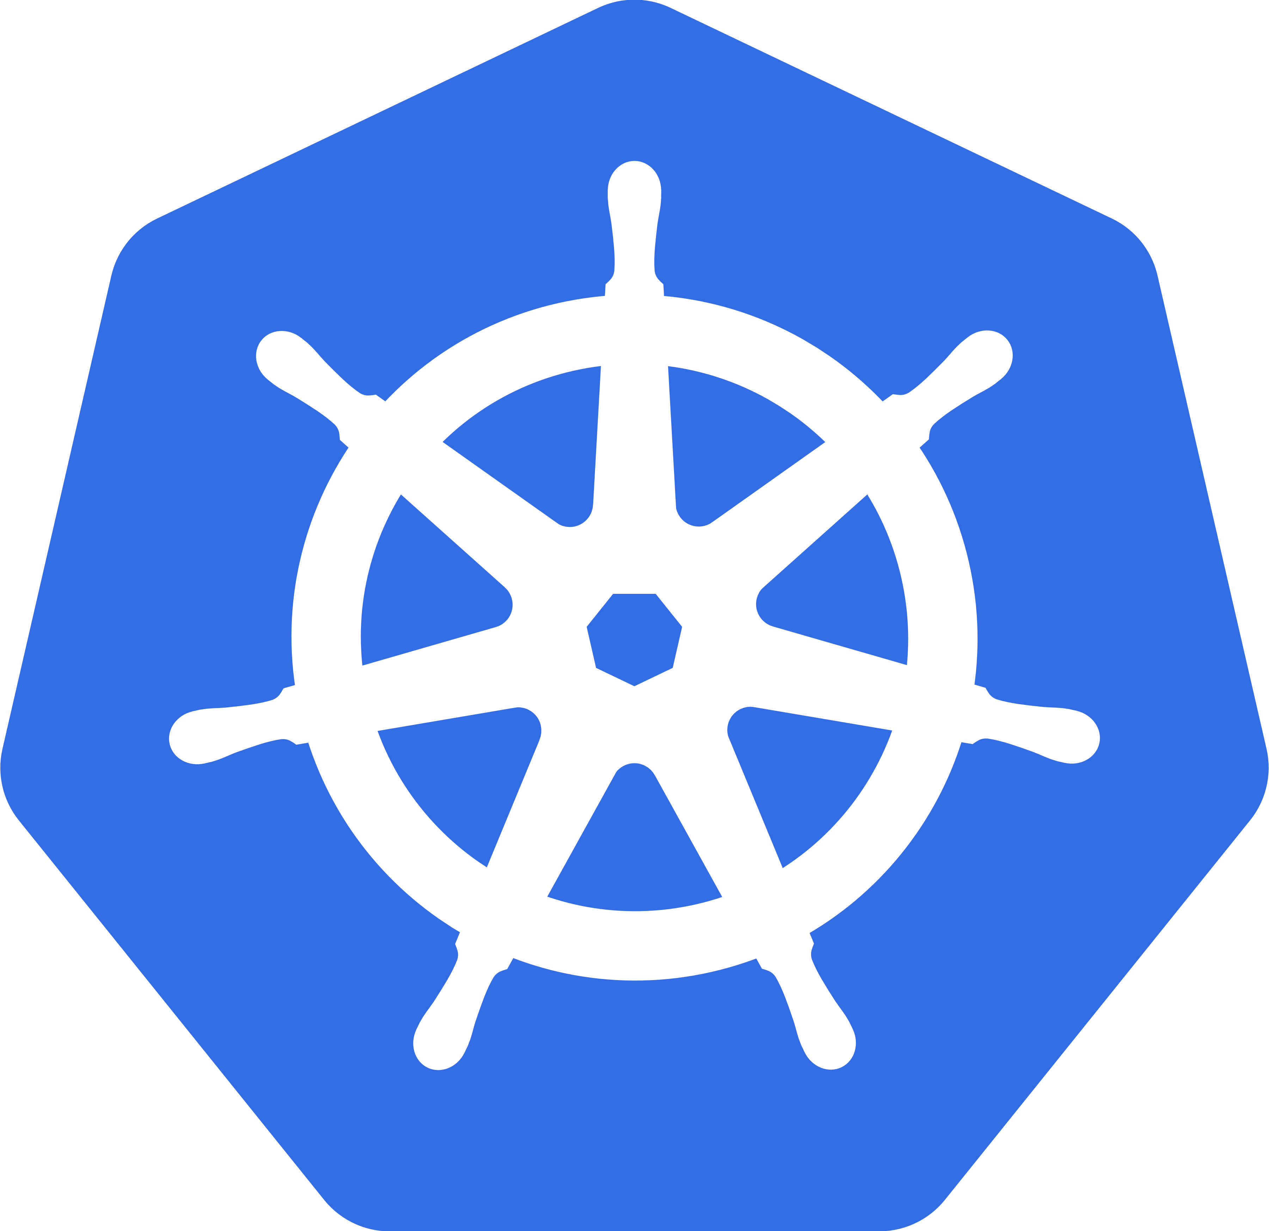
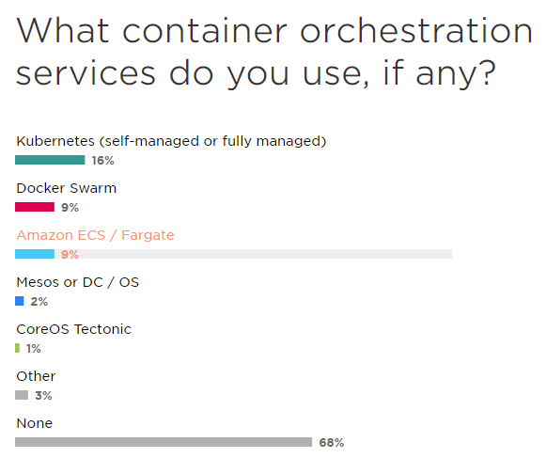
Kubernetes
Quickly becoming the standard
Largest community behind it
Major Vendors backing & contributing
Google, AWS, Microsoft, Red Hat
Can be challenging to setup
kops - https://github.com/kubernetes/kops
All major cloud providers quickly adding managed implementation
Amazon Elastic Container Service for Kubernetes (EKS)
AWS Workshop for Kubernetes - https://github.com/aws-samples/aws-workshop-for-kubernetes
From JetBrains 2018 Survey

Slide 25
Container Environment
Serverless Environment
Container Registry
(Amazon ECR, Docker Hub)
Cluster
Container Instances
T1
T1
T2
T2
T3
T4
T5
T3
T4

Slide 26

So what is the right tech to use?

Slide 27
Serverless
Containers
Continuous Scaling
Spikey or low traffic patterns
Reduced DevOps
Great for asynchronous processing
Responding to service events
In many case can be order of magnitude cheaper to run
Control of Compute Environment
Highly consistent low latency
Cloud agnostic tooling
Docker CLI (docker)
Kubernetes CLI (kubectl)
Long running processing
No restrictions of language runtimes or types of applications
Real-time communication

Slide 28
Check Demo Results

Slide 29
Recap
Overview of what is a Serverless environment
Learned what is AWS Lambda
Lambda function’s lifecycle and how it scales
How to use .NET Core with Lambda
What are the major components of Container environment
How does it compares with a Serverless environment
Looked at some AWS Container offerings
AWS Batch
AWS CodeBuild
Amazon Elastic Container Service
Got a better understanding of when to use each tech

Slide 30
AWS Tools for .NET Developers
AWS SDK for .NET
NuGet package for each service (i.e. AWSSDK.S3 and AWSSDK.Lambda)
GitHub - https://github.com/aws/aws-sdk-net
AWS Lambda for .NET Core
GitHub - https://github.com/aws/aws-lambda-dotnet
AWS Toolkit for Visual Studio
Market Place - https://marketplace.visualstudio.com/items?itemName=AmazonWebServices.AWSToolkitforVisualStudio2017
AWS Extensions for the Dotnet CLI (dotnet lambda deploy-function MyFunction)
AWS Lambda, AWS Elastic Beanstalk and Amazon Elastic Container Service
GitHub - https://github.com/aws/aws-extensions-for-dotnet-cli
AWS Tools for PowerShell
Supports both PowerShell and PowerShell Core for cross platform support
AWS Tools for Visual Studio Team Services
Marketplace - https://marketplace.visualstudio.com/items?itemName=AmazonWebServices.aws-vsts-tools
GitHub - https://github.com/aws/aws-vsts-tools

Slide 31
Thank You!
Norm Johanson
Twitter: @socketnorm
AWS .NET Developer Blog: https://aws.amazon.com/blogs/developer/category/net/
Conference Code: https://github.com/normj/NDCOsloServerlessAndContainers
GitHub Repos
AWS .NET Lambda Tools: https://github.com/aws/aws-lambda-dotnet
AWS Extensions for Dotnet CLI: https://github.com/aws/aws-extensions-for-dotnet-cli
AWS Tools for VSTS: https://github.com/aws/aws-vsts-tools
AWS SDK for .NET: https://github.com/aws/aws-sdk-net

